Slide 1
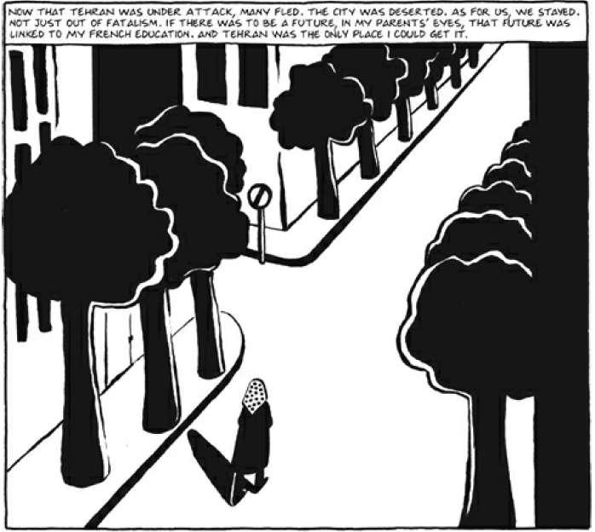
Group Panel Analysis
COLOR
Things that are black: the trees, Marji’s clothes, her shadow
Things that are white: the street, building, sidewalks
The path is white, reminds me of the yellow brick road, it’s blank, not colored in → unknown future
She’s dressed in black and white, shows the uncertainty.
WORDS vs PICTURES
The caption narrates how many fled, but they stayed → ironic that people are fleeing because there is no future, but they stay because this is the only place for a good future.
Picture isn’t what you would expect for a bright future. Shows that their decision was strange – emphasizes that they are the only ones who thought to stay
PERSPECTIVE
We don’t see Marji’s front
Bird’s eye view
The scene goes on, past the frame. It shrinks the further it goes → future is narrow, limited opportunity?
The closest part to us is larger

Slide 2
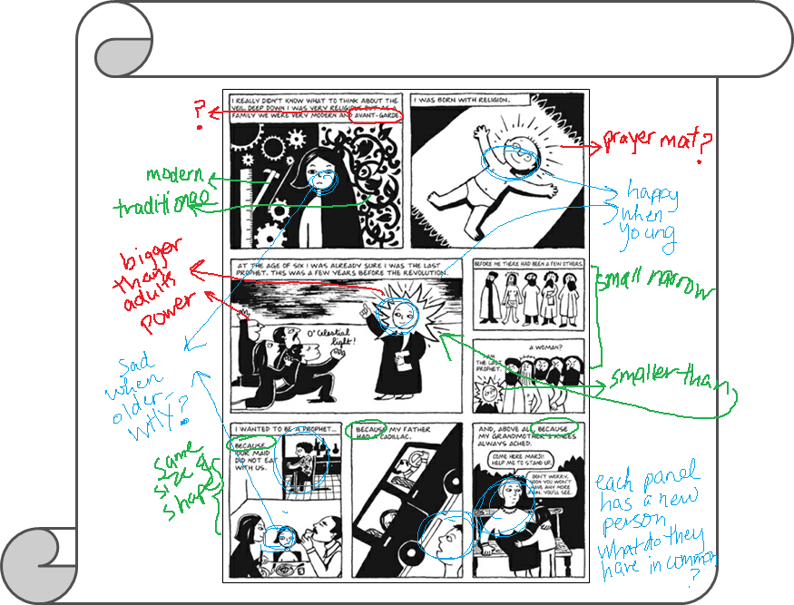
Gallery Walk

Slide 3
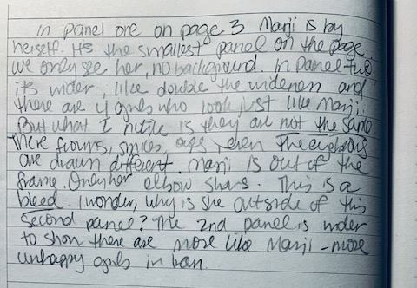
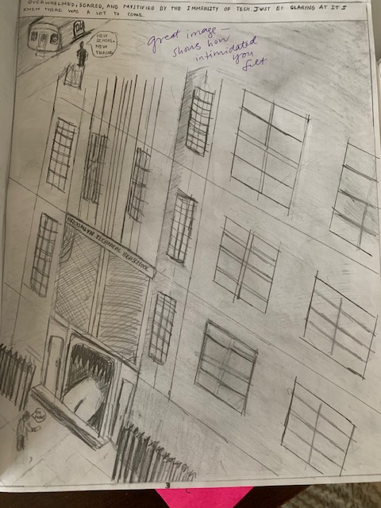
Panel Journals
Close reading, questions, observations, notes on closure
Experiments with panels and devices
Intriguing or puzzling panels and devices

Slide 4
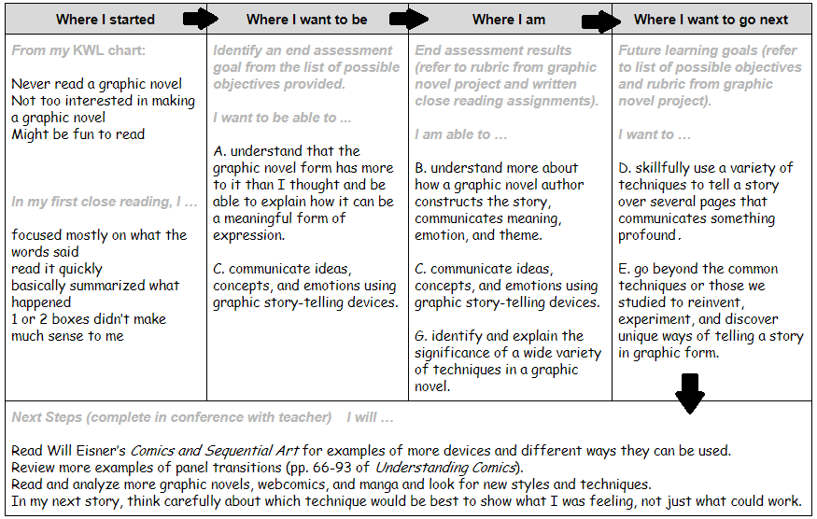
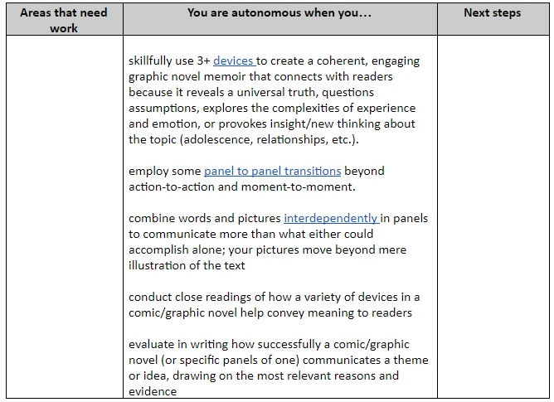
Resources shvetamiller.com

